Slide 1
Stem Cells

Slide 2
iPSC and hESC
iPSC = induced pluripotent stem cells
→ reprogramming of differentiated somatic cells to a pluripotent state
hESC = human embryonic stem cells
→ from inner cell mass of developing embryos
Both stem cells are able to make all types of specialized cells
It is unclear if there are differences between the two stem cell types
E. A. Kimbrel; R. Lanza Current status of pluripotent stem cells: moving the first therapies to the clinic, NATURE REVIEWS 2015, 14, 681-692

Slide 3
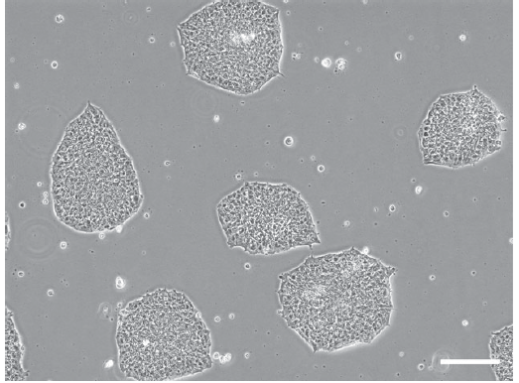
Advantages of iPSC
Avoiding the use of embryos
capable of generating autologous and non-immunogenic patient-specific therapies
can more easily provide cell-based disease models
Ohnuki M, Takahashi K.2015 Present and future challenges of induced pluripotent stem cells. Phil. Trans. R. Soc. B
E. A. Kimbrel; R. Lanza Current status of pluripotent stem cells: moving the first therapies to the clinic, NATURE REVIEWS 2015, 14, 681-692

Slide 4
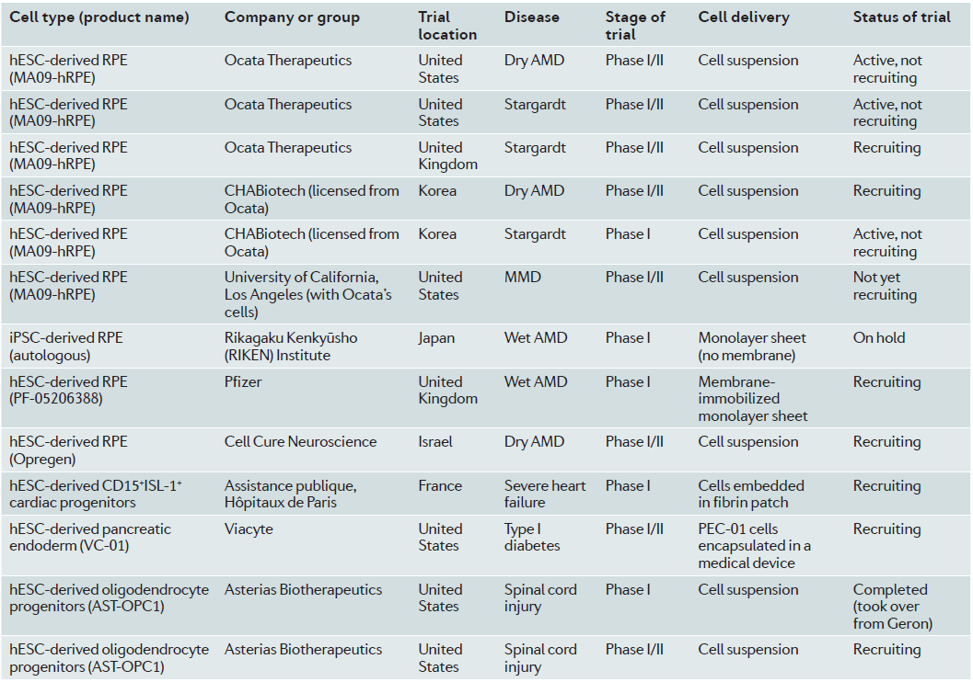
E. A. Kimbrel; R. Lanza Current status of pluripotent stem cells: moving the first therapies to the clinic, NATURE REVIEWS 2015, 14, 681-692

Slide 5
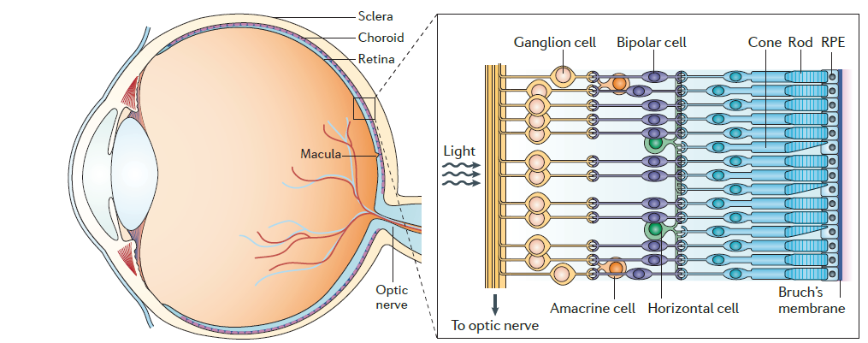
Example for clinical use: AMD
AMD = age-related macular degeneration
→ Damage of RPE cells
→ progressively damages the macula, which leads to blindness
E. A. Kimbrel; R. Lanza Current status of pluripotent stem cells: moving the first therapies to the clinic, NATURE REVIEWS 2015, 14, 681-692

Slide 6
AMD treatment
Sample of patients skin cells
Derived into iPSC
Differentiated into RPE cells
Small sheet of these cells were slipped into the retina of the eye
Results: - brighter eyesight after operation
- halted further deterioration of the eye

Slide 7
Problems with stem cells in clinical use
Too slow and expensive to grow patient specific stem cells
would ensure that recipients immune system would accept the new cells
solution: developing banks of premade donor cells
Cancer
→ mutations during in vitro growth can later lead to development of cancer in the patient

Slide 8
Engineering Stem Cell Organoids
Yin, Xiaolei & Mead, Benjamin & Safaee, Helia & S Langer, Robert & Karp, Jeffrey & Levy, Oren. (2016). Engineering Stem Cell Organoids. Cell Stem Cell. 18. 25-38. 10.1016/j.stem.2015.12.005.

Slide 9
What are Organoids?
Small, self organized, 3D tissue cultures derived from stem cells
They offer a good model system for research on cell growth, interaction, differentiation
Can potentially be used in medicine as an alternative to transplants or to cure single-gene hereditary diseases
How are organoids designed and engineered?
What has been accomplished using organoids?

Slide 10
Why Use Organoids?
They offer a better system than
2D monocultures of cell lines as these usually lack cell-cell and cell-matrix interaction
tumor cells as these lack relevant tissue organization
tissue explants as these are difficult to maintain and quickly lose their phenotype
Organoids are spatially organized, have cell-cell and cell-matrix interactions and can be cultivated and manipulated
However, it is difficult to control cell type,interaction, and organization

Slide 11
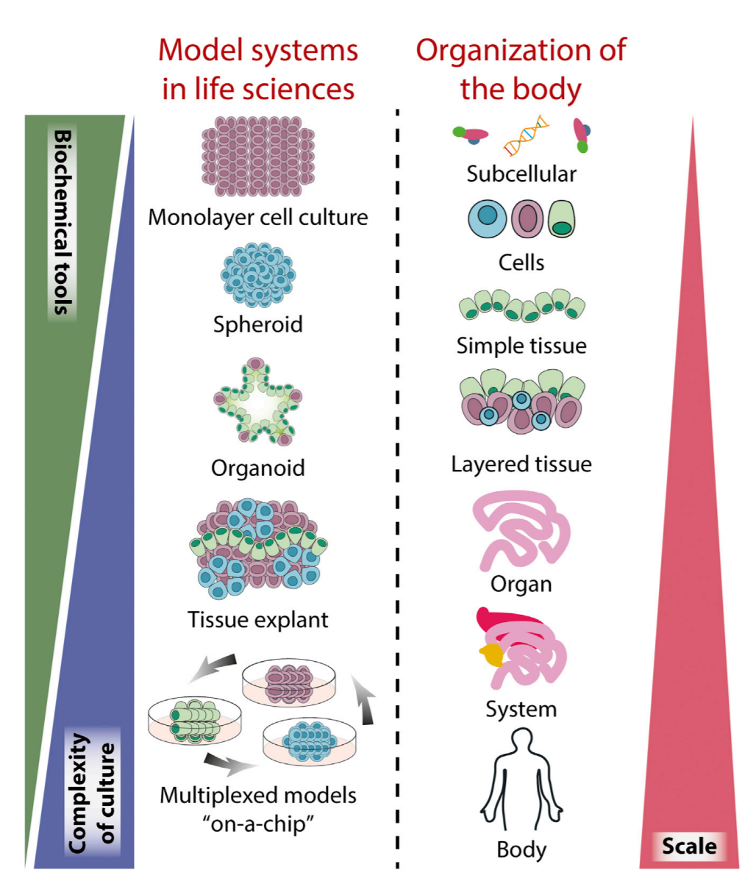

Slide 12
Design of Organoids
The design has to be specific to the function
This can be accomplished by modifying the niche
Modeling developmental processes requires close mimicking of in vivo tissue
Growing tissue for transplants is simpler, but requires expansion of the tissue
Drug screenings require mimicking all relevant aspects of the target tissue

Slide 13
What has to be Considered for the Niche
The niche describes the microenvironment of the organoid. These factors have to be considered:
Signaling mechanisms
Niche support
ECM
Mechanical forces
Oxygen levels
pH levels
This can be difficult to manipulate properly

Slide 14
Potential in Medicine
Cells of patients with hereditary diseases could be harvested
These could subsequently be modified with systems such as CRISPR-Cas9 homology-directing repair
The cells could be grown into an organoid
The organoid can be transplanted into the affected tissue
The modified cells are able to compensate the loss of function of the defective gene

Slide 15
Achievements to Date
So far, intestine and brain organoids have been created
Both represent decent modeling systems…
…but both still have many limitations
The lack of surrounding tissue and body axis change the shape of the tissue
More sophisticated tissue organization is wanted

Slide 16
Conclusion
Organoids are useful in biological and medical research
Although many advances have been made, there are still many issues to fix
Most presented solutions are possibilities, but do not necessarily solve all problems completely
Has the potential to revolutionize treatments for cancers and hereditary diseases

Slide 17
Use of organoids
Advantages: good model system and high relevance for humans, they can be kept for a years without genomic alterations, most established experimental techniques can be applied (RNAi, CRISPR), wide variety of tissues can be generated, diseases that are difficult to study in animal models can be done so with human derived tissue

Slide 18
Uses of organoids
Organoids are useful to study a variety of tissues:
Cerebral cortex: Understand brain development and neurodegenerative diseases
Intestine: Personalized organoids for identifying personalized drugs
Kidney: Testing of toxicity and transplantation
Breast: Study tumour development
Heart: Study cardiac development and interaction with drugs

Slide 19
Organoids in tissue development and disease
Personalized medicine from patient derived tissue: Sequencing identifies mutations in patients. With this knowledge, we can grow patient derived organoids and develop drugs specifically to treat the patient.
In certain cases, the organoid culture can be modified with CRISPR/Cas9 and later be transplanted to the patient.

Slide 20
Therapeutics and drug development
Furthermore, organoids can be cultured to study tumor development and the acquisition of drug resistance.
It fails in modelling inflammatory responses, probably due to the fact that this mechanism involved several different systems and complex mechanisms.
As of now, we can only study one organoid culture at a time, without its interaction to other organoids.

Slide 22
Ethical Dimension of Organoids
organoids = stem-cells derived structures generated in vitro
developement promising for medical research, drug discovery, toxicology
ethical implications for various issues (biobanking, policies on animal and human embryos etc.)

Slide 23
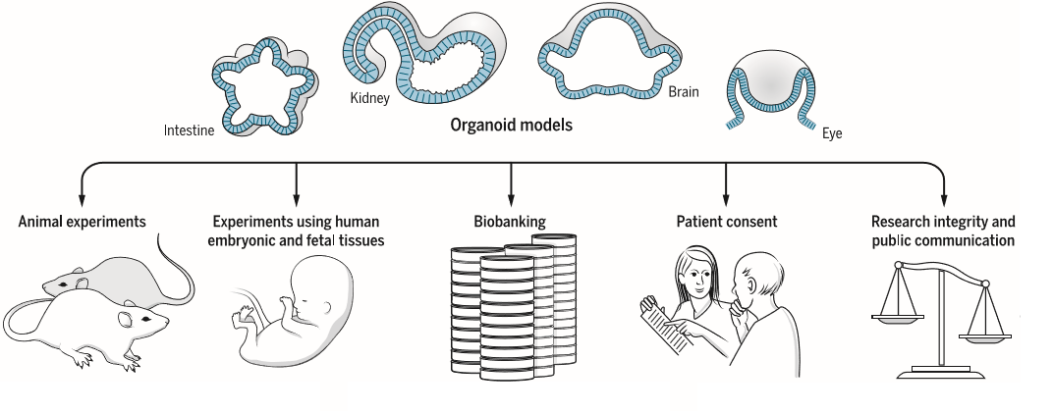
Ethical Dimension of Organoids

Slide 24
Animal experiments
replacement, reduction and refinement (3Rs)
reduction-refinement conflicts
Animal models have been successful
differences in metabolism and regulation of size and lifespan
Organoids offer an alternative ……..

Slide 25
Experiments Using Fetal Cells
human embryo deserves full protection starting with fertilization
early embryo has some moral standing increasing through out development and pregnancy
embryos can conditionally be created and used for research

